Slide 1


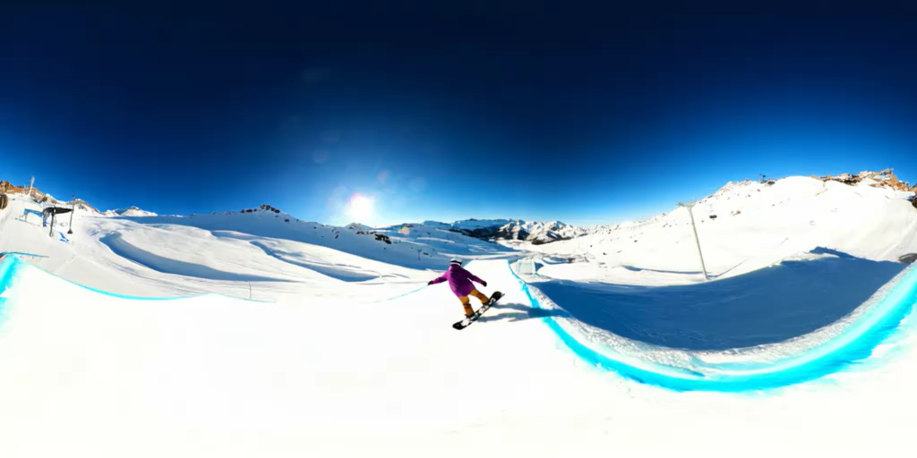
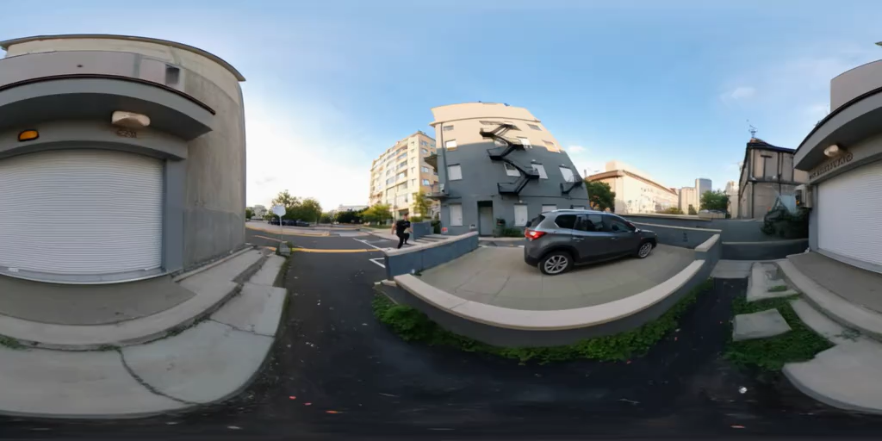
360Anything: Geometry-Free Lifting of Images and Videos to 360°
Ziyi Wu, Daniel Watson, Andrea Tagliasacchi,
David J. Fleet, Marcus A. Brubaker, Saurabh Saxena
arXiv 2026
Website: https://360anything.github.io/
Notes:
I’m gonna present my latest work, 360Anything, which is done during my internship at Google DeepMind. In this paper, we proposes a framework that generates 360deg panoramas from perspective image and video

Slide 2

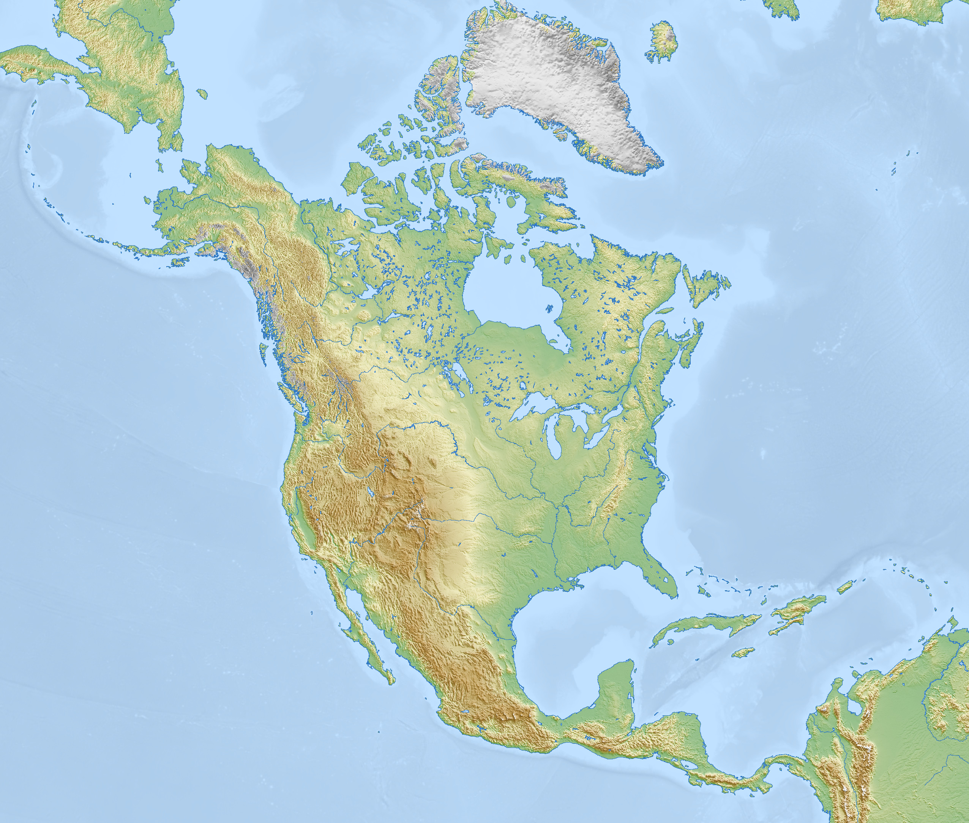
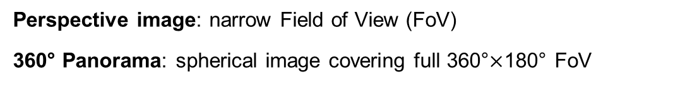
What is 360° Panorama?
Perspective image: narrow Field of View (FoV)
360° Panorama: spherical image covering full 360°$×$180° FoV
https://en.wikipedia.org/wiki/Equirectangular_projection
Notes:
I bet the question in your mind rn is, what is a 360deg panorama? Don’t worry, you already know what it is since you were a kid
Just think of this globe, which is a sphere with a texture image on it
So, what we usually call an image is like a local crop from the globe, which covers a narrow FoV like 60deg. We call this a perspective image
In contrast, a 360deg panorama is the image on the sphere, which covers the entire 360deg horizontal and 180deg vertical FoV. So a perspective image can be considered as a projection from a panorama image

Slide 3
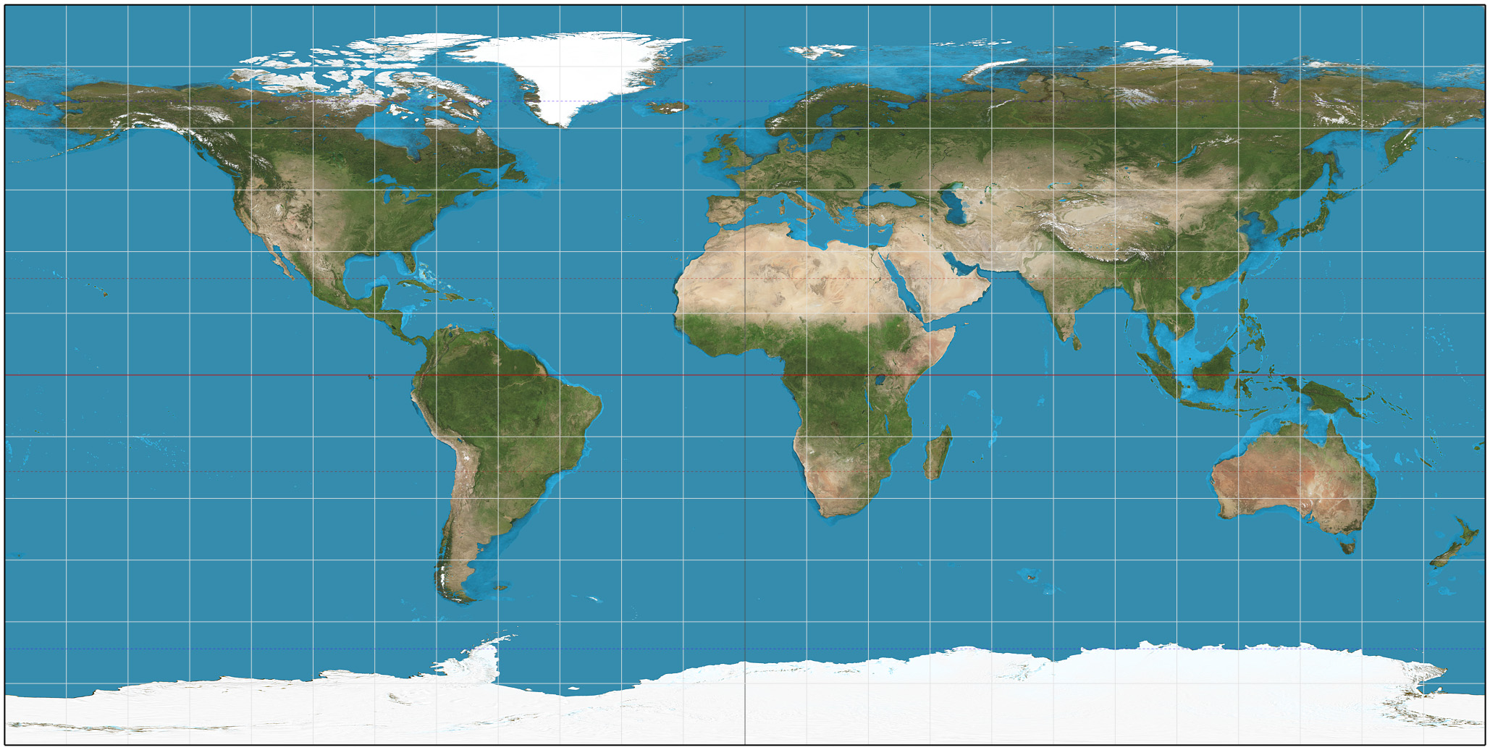
360° Panorama as 2D Image
Can we represent panoramas as 2D images?
Equirectangular Projection Space (ERP)
https://en.wikipedia.org/wiki/Equirectangular_projection
Notes:
It’s always hard for computer to process irregular data like a sphere
People thus proposed the equirectangular projection space, ERP
which flattens a spherical image to a 2D image. Just like this world map you often see. In this talk, I’ll use the word 360deg image, panorama image, and ERP image interchangeably

Slide 4
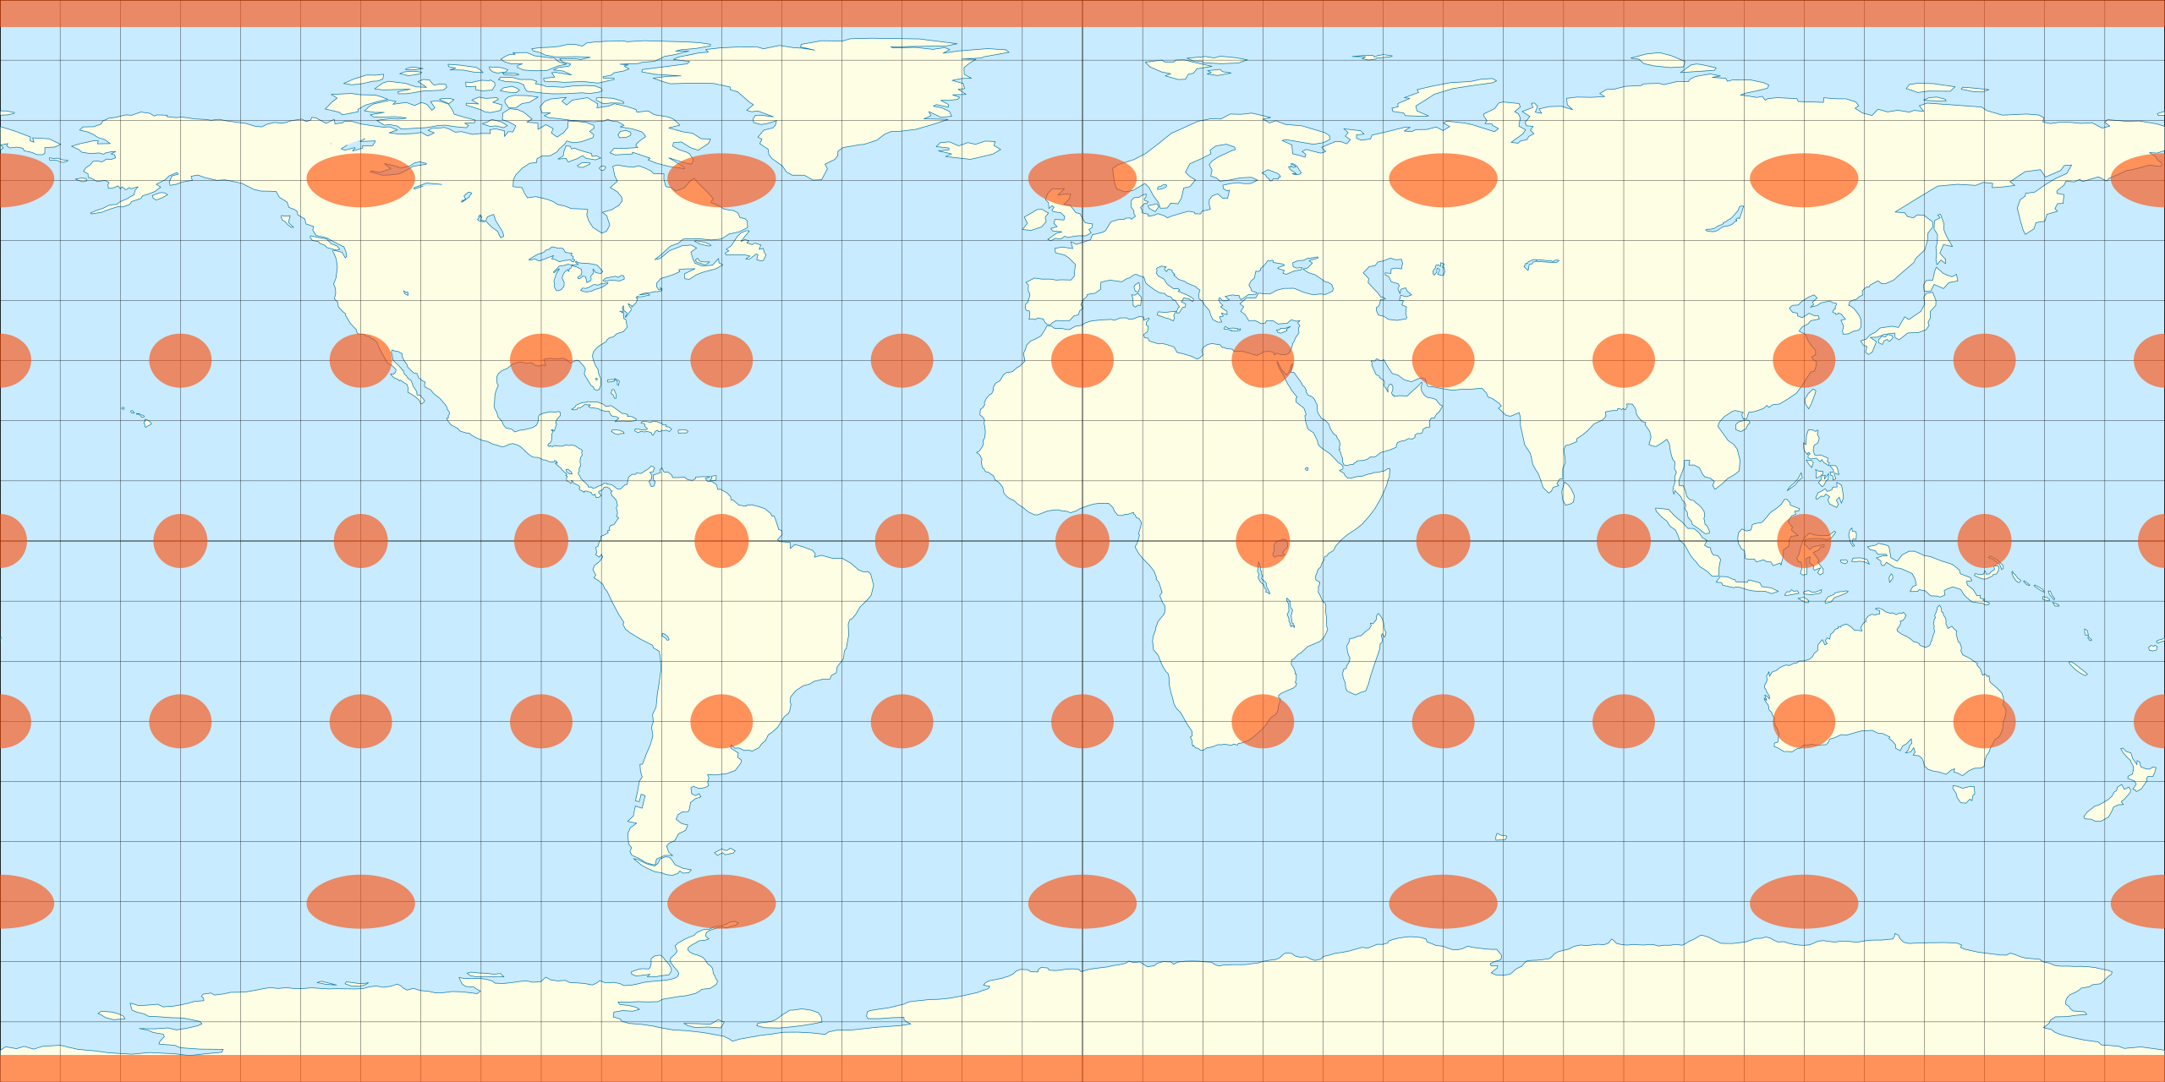
Properties of ERP
Small distortion near equator, large distortion around poles
https://en.wikipedia.org/wiki/Equirectangular_projection
Notes:
A bit more background about this ERP representation: it introduces distortions on the map. Along the equator the distortions are small, yet it’s huge around the pole, because you flatten a point to a horizontal line

Slide 5
Properties of ERP
Small distortion near equator, large distortion around poles
Left and right side should connect
https://en.wikipedia.org/wiki/Equirectangular_projection
Notes:
Another property of ERP is its boundary continuity
If you crop its left, and right side, and put them together, they should seamlessly connect. This is because ERP comes from a sphere, and sphere has a continuous surface

Slide 6
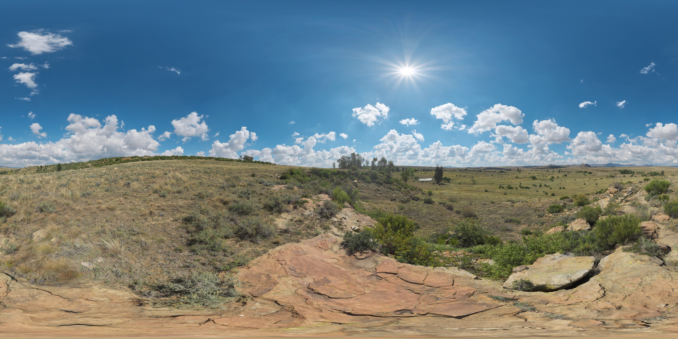
Why 360° Panorama?
Simulation: captures scene lighting (env map)
https://polyhaven.com/hdris
Notes:
So, why do we study panorama? Why are they important?
Panoramas have a wide range of applications, to name a few, in simulation, it’s common to use a 360deg image as the environment map, to store the lighting and other properties of a scene

Slide 7
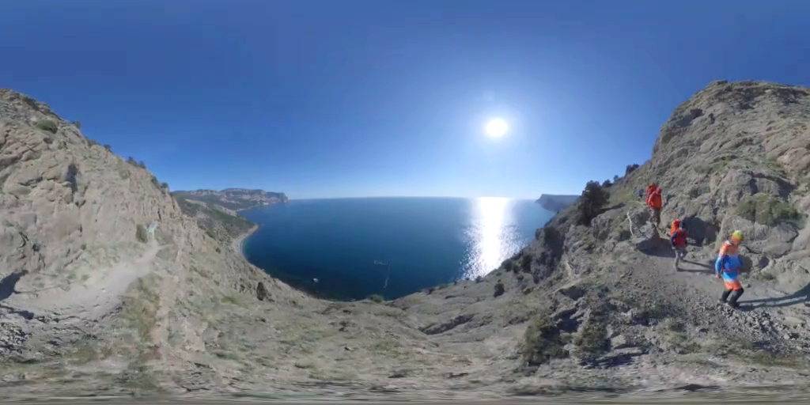
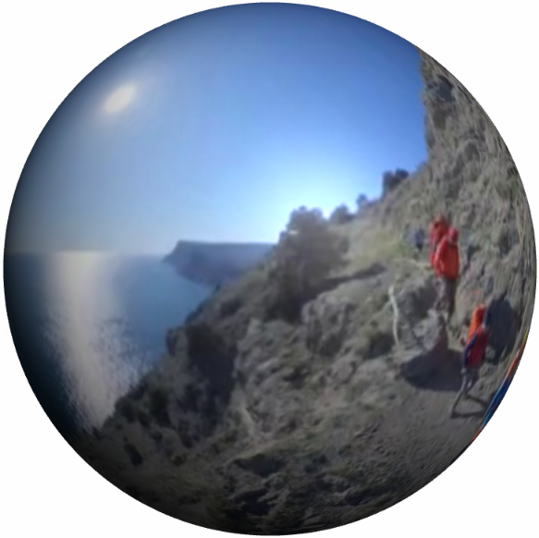
Why 360° Panorama?
Gaming: no delay when moving camera
Notes:
Also, in gaming, like in VR games, it eliminates delays in rendering new views when you move your head
Let’s say we store this scene on a sphere

Slide 8
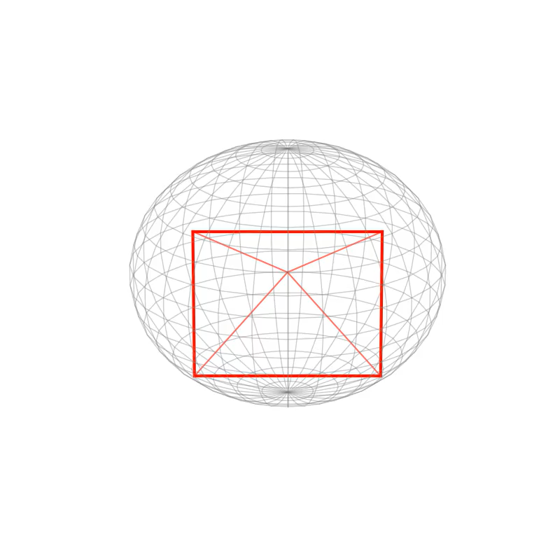
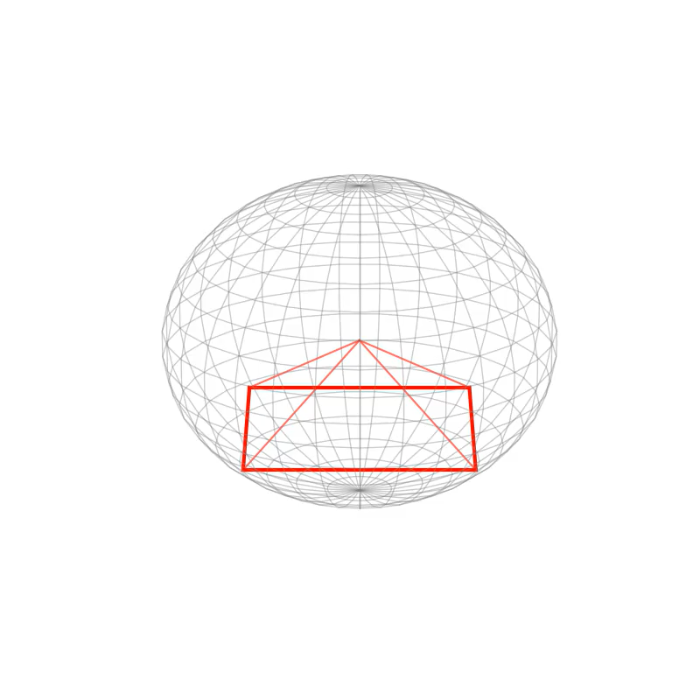
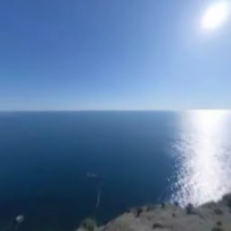
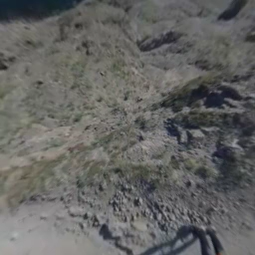
Why 360° Panorama?
Gaming: no delay when moving camera
Notes:
Now if you move the camera horizontally or vertically, it’s just cropping a perspective view from the sphere, thus very fast

Slide 9
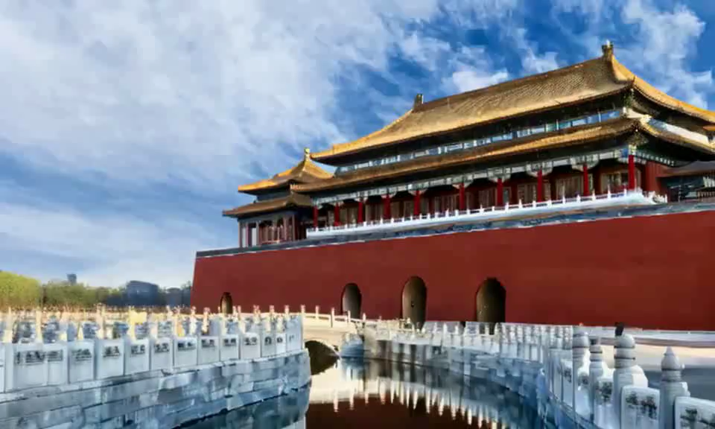
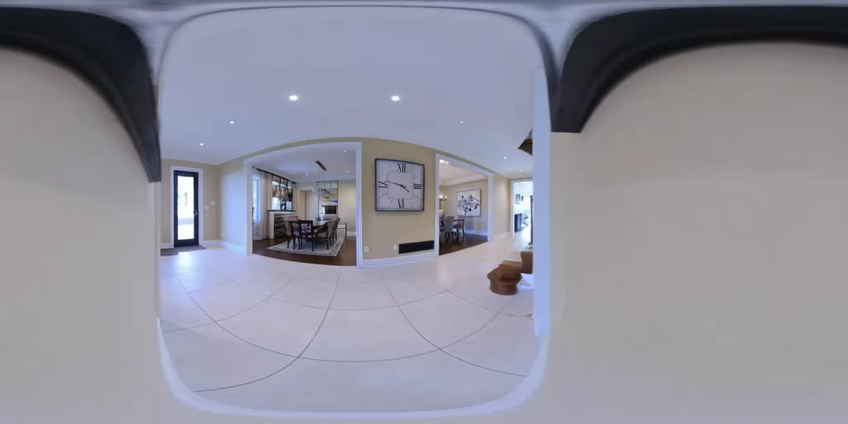
Why 360° Panorama?
Video generation: enforces 3D consistency
Li, Runjia, et al. "VMem: Consistent Interactive Video Scene Generation with Surfel-Indexed View Memory." ICCV. 2025.
Notes:
For me specifically, I think of panorama as a potential way to fix the 3D consistency issue in video models
Video models have this forgetting issue, when you move the camera away and move back, the scene may change completely. It doesn’t really have the concept of object permanence. We argue that this is because current video models only capture a narrow view of the physical world, without fully understanding its 3D nature
In contrast, if we generate a 360deg video, we force the model to cover every object in the scene in its output. So the objects are always there and thus the model won’t forget

Slide 10
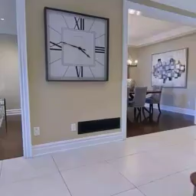
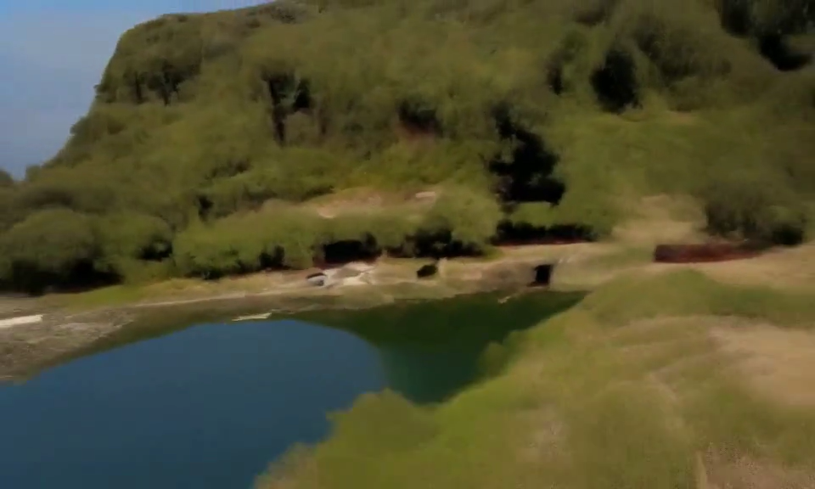
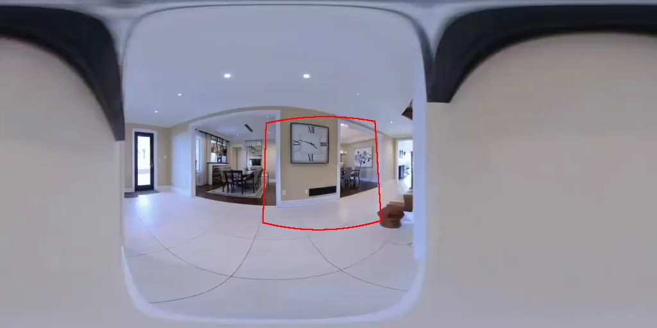
Why 360° Panorama?
Video generation: enforces 3D consistency, implicit memory
More “scalable” than explicit ones, e.g., point clouds
Li, Runjia, et al. "VMem: Consistent Interactive Video Scene Generation with Surfel-Indexed View Memory." ICCV. 2025.
Notes:
For example, a perspective video of this scene may look like this, there is a clock at the beginning, and then it’s out of view. In contrast, it’s always in the panorama video
Overall, I feel that panorama can serve as an implicit memory mechanism for the model. To solve the 3D consistency issue, recent works often use explicit memory mechanism such as 3D point cloud, yet the bitter lesson tells us that explicit or hand-crafted components always prevent scaling. Panoramas are just extra raw pixels, so it’s implicit 3D and they could work better. This is why I find this representation interesting and want to explore this direction

Slide 11
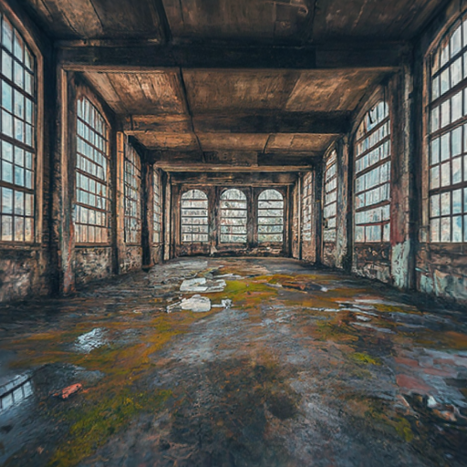
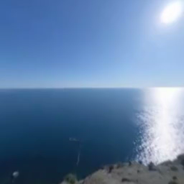
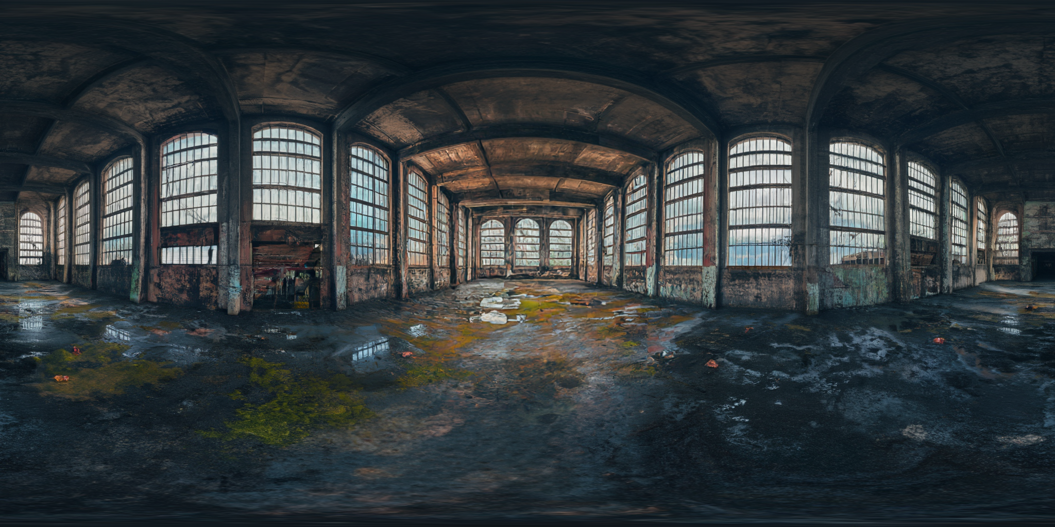
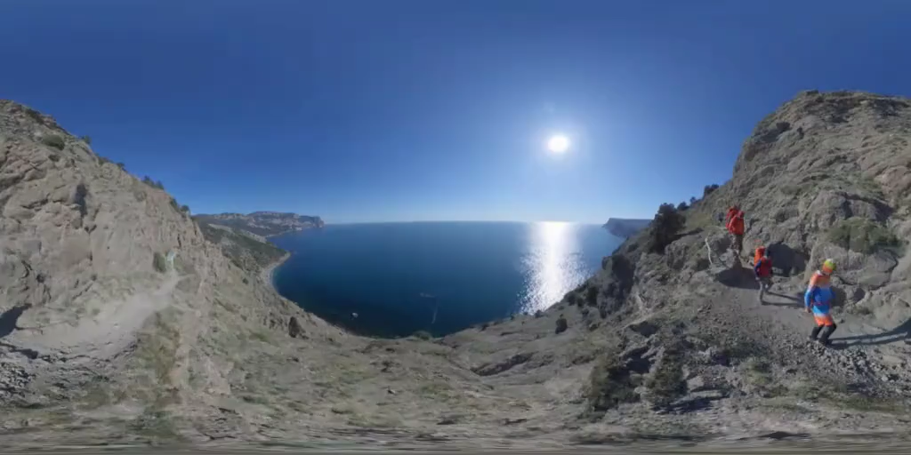
Task: Perspective-to-360°
Notes:
In this paper, we tackle the task of perspective to 360deg generation
We want to work for both image
and video. We always generate in the 2D ERP format
In the rest of the slides, I will use video to explain our work because image is just video with only one frame

Slide 12
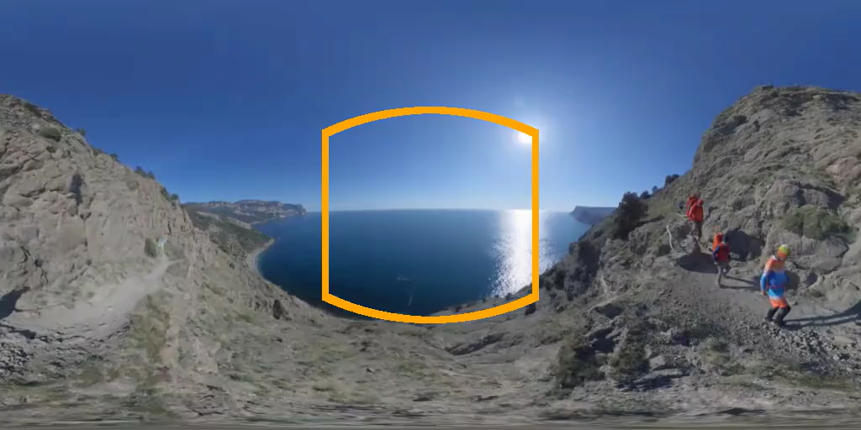
Challenges
Where to place perspective on panorama?
How to ensure left-right continuity (no “seam”)
Notes:
Looking at this perspective and panorama pair, what are the challenges here?
Well, first of all, how do you establish a correspondence between the perspective and the ERP space? Where should I place the input, and where should I hallucinate new context?
Second, how to ensure the left-right continuity of an ERP image? Because to the model, the left and right side pixels are actually the farthest from each other, yet you have to make sure they are very similar

Slide 13
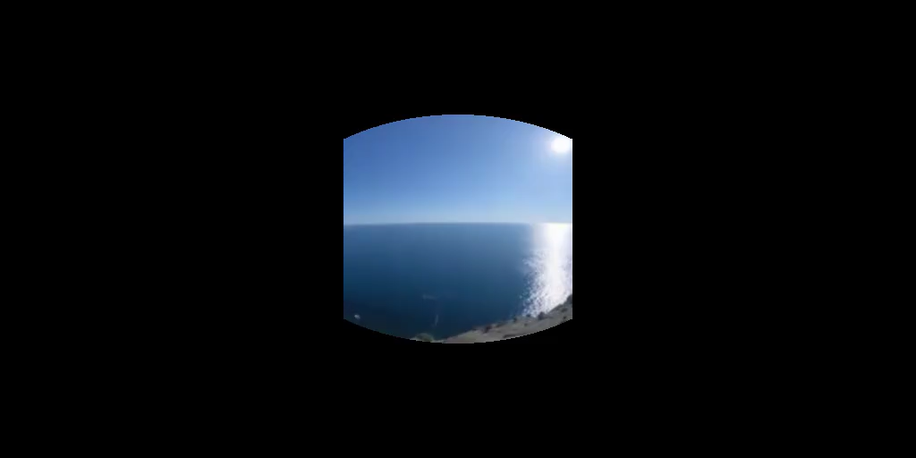
Prior Work: Two-Stage
Project perspective to ERP space, channel-concat
This requires camera metadata!
Can use off-the-shelf estimators?
Luo, Rundong, et al. "Beyond the Frame: Generating 360° Panoramic Videos from Perspective Videos." ICCV. 2025.
Notes:
For challenge 1, prior works often take a two-stage approach
Instead of directly going from perspective to panorama
they first project the perspective data to the ERP space, so that it becomes pixel-aligned with the target
Then, they concatenate the projected panorama and the target panorama channel-wise to run diffusion
This pixel-aligned projection imposes a strong inductive bias and effectively reducing the task to simple outpainting. Yet, it requires known camera metadata, such as Field-of-View (FoV) and camera pose, to project to the orange regions. For in-the-wild data, such metadata is often unavailable
Ofc, you can use off-the-shelf estimator for this

Slide 14
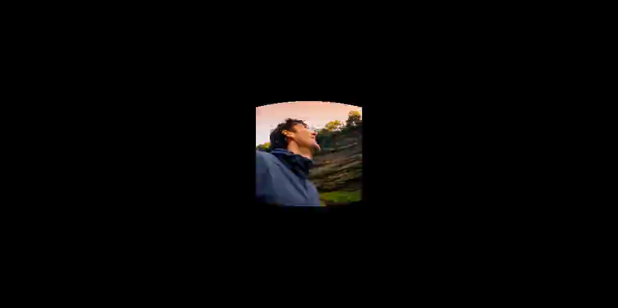
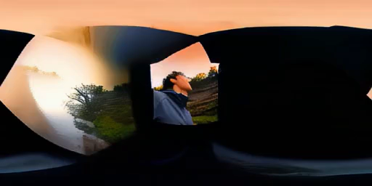
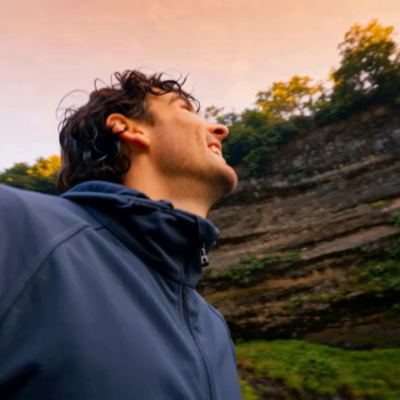
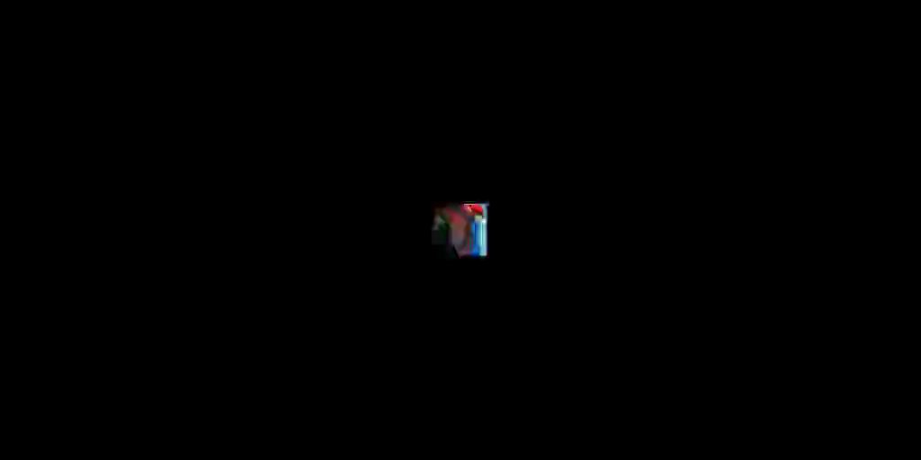
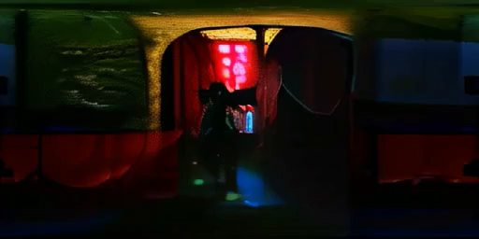
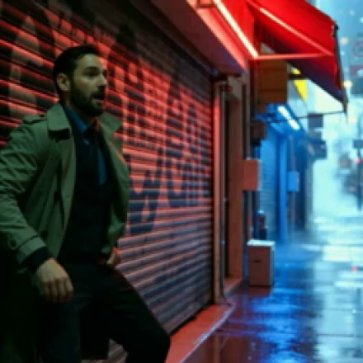
Prior Work: Two-Stage
Input
MegaSaM Pose
Generation
Li, Zhengqi, et al. "MegaSaM: Accurate, fast and robust structure and motion from casual dynamic videos." CVPR. 2025.
Notes:
However, when the estimator fails, the generative model breaks completely
Here we show an input perspective video with a challenging camera motion,
and the MegaSaM estimated trajectory, where the roll angle is completely off
As a result, the outpainted panorama video is broken
Here is another example, MegaSaM predicts a very small FoV, leading to broken generation again. Indeed, two-stage methods inevitably have the error accumulation issue, and the generative model is impossible to correct a wrong pixel-aligned conditioning

Slide 15
Our Approach: End-to-End
Pixel-aligned projection is a “scaffold”
A large Transformer can learn it from data!
Notes:
We argue that pixel-aligned projection is a scaffold for the model. Recent research, such as in LLM agent, shows that scaffold is only needed when the base model is weak; yet if your model and data is large enough, scaffold underperforms end-to-end approaches
In this paper, we prove that a large Transformer can learn the perspective-to-ERP relationship purely from data. After all, it’s just finding pixel correspondence, and self-attention is good at this

Slide 16
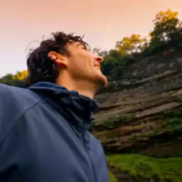
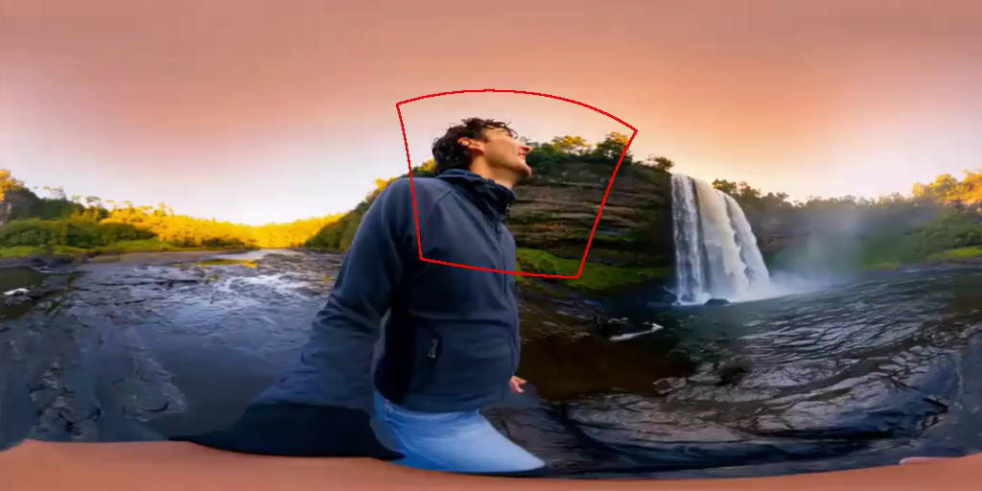
Our Approach: End-to-End
Pixel-aligned projection is a “scaffold”
A large Transformer can learn it from data!
Generative prior helps camera estimation
Notes:
In addition, the generative prior in a diffusion model can also help camera estimation
In this example, MegaSaM predicts a large roll angle and the projected water surface is almost perpendicular to the horizon
In contrast, a pre-trained generator knows that water surface is often parallel to the horizon, so it generates a correct panorama

Slide 17
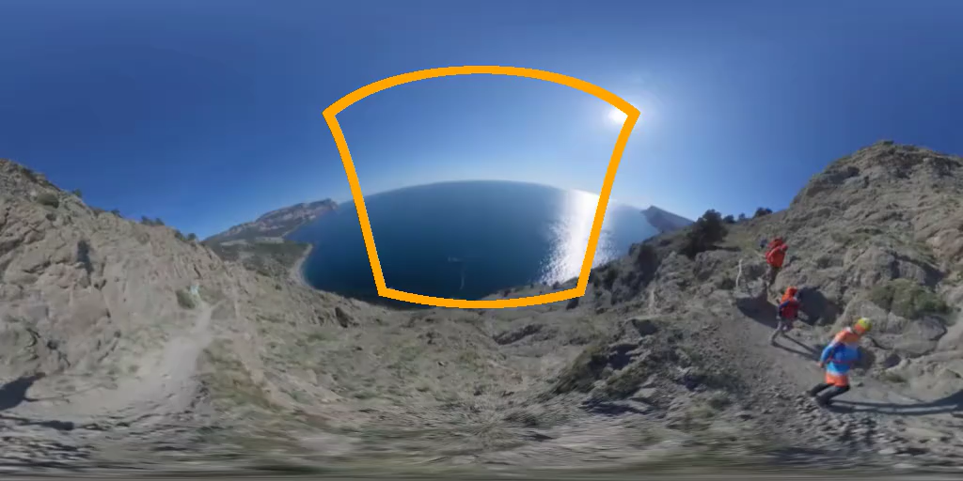
Our Approach: End-to-End
Coordinate frame ambiguity
Panorama can have arbitrary orientations
We canonicalize data to be gravity-aligned!
Notes:
There is one thing I want to clarify here. Since we don’t provide explicit camera poses to the model, the output panorama can be in any coordinate frame. After all, from the perspective video we can only infer the relative rotation of the camera, yet we don’t know the initial pose. The panorama can look like this, whose gravity direction points down
Yet, it can also be like this,
or even this. The orange trajectories will produce the same perspective video in all these cases
To eliminate ambiguity, we pre-process all training data to follow this gravity-aligned canonical pose. Intuitively it is better than the other two options, because often people care most about content around the horizon, the canonical pose puts the horizon on the equator which has the least distortion. The first one is the worst – to always place the perspective input at the center, you have to learn different spherical distortion patterns depending on the actual pose of the input, while for a canonical pose, the sky is always at the top and the ground is at the bottom, the distortion is somewhat fixed

Slide 18
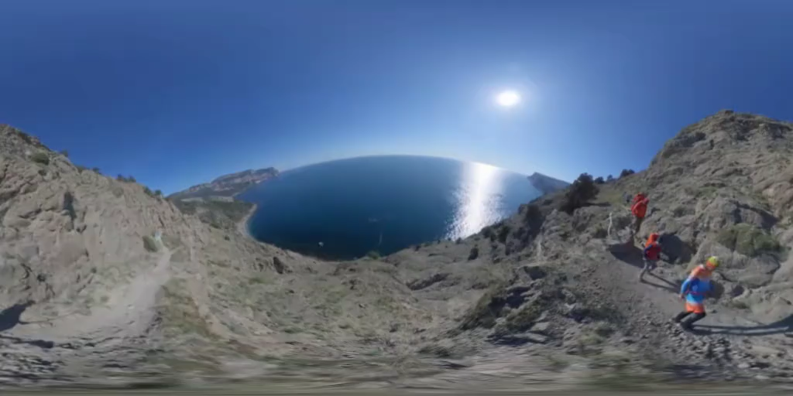
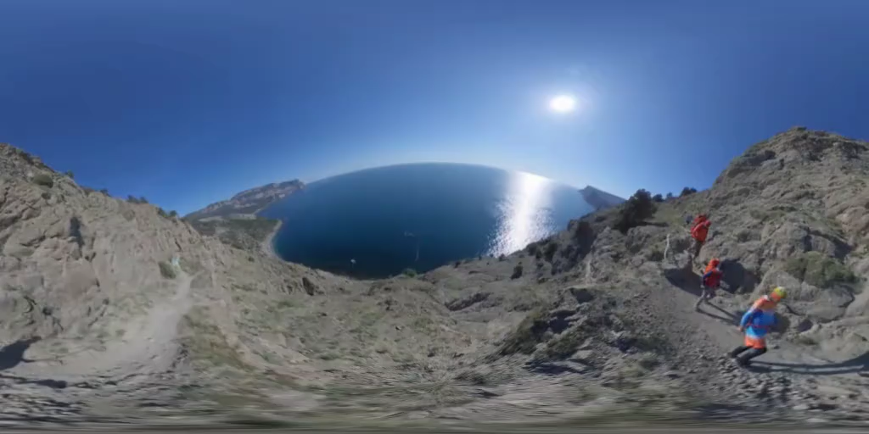
Data Canonicalization
Two steps: 1) remove inter-frame rotation (COLMAP), 2) align gravity direction (GeoCalib)
Raw
Stabilized
Canonicalized
Veicht, Alexander, et al. "Geocalib: Learning single-image calibration with geometric optimization." ECCV. 2024.
Notes:
Here are some examples of our data canonicalization pipeline. The raw panorama videos have shaking cameras since it’s held by a walking man. We first estimate per-frame camera pose, and rotate each frame to have zero rotation relative to the first frame. This step is called video stabilization. Now all frames should have the same gravity direction. So we run GeoCalib to estimate it, and rotate the entire video to align the gravity direction with the vertical axis

Slide 19
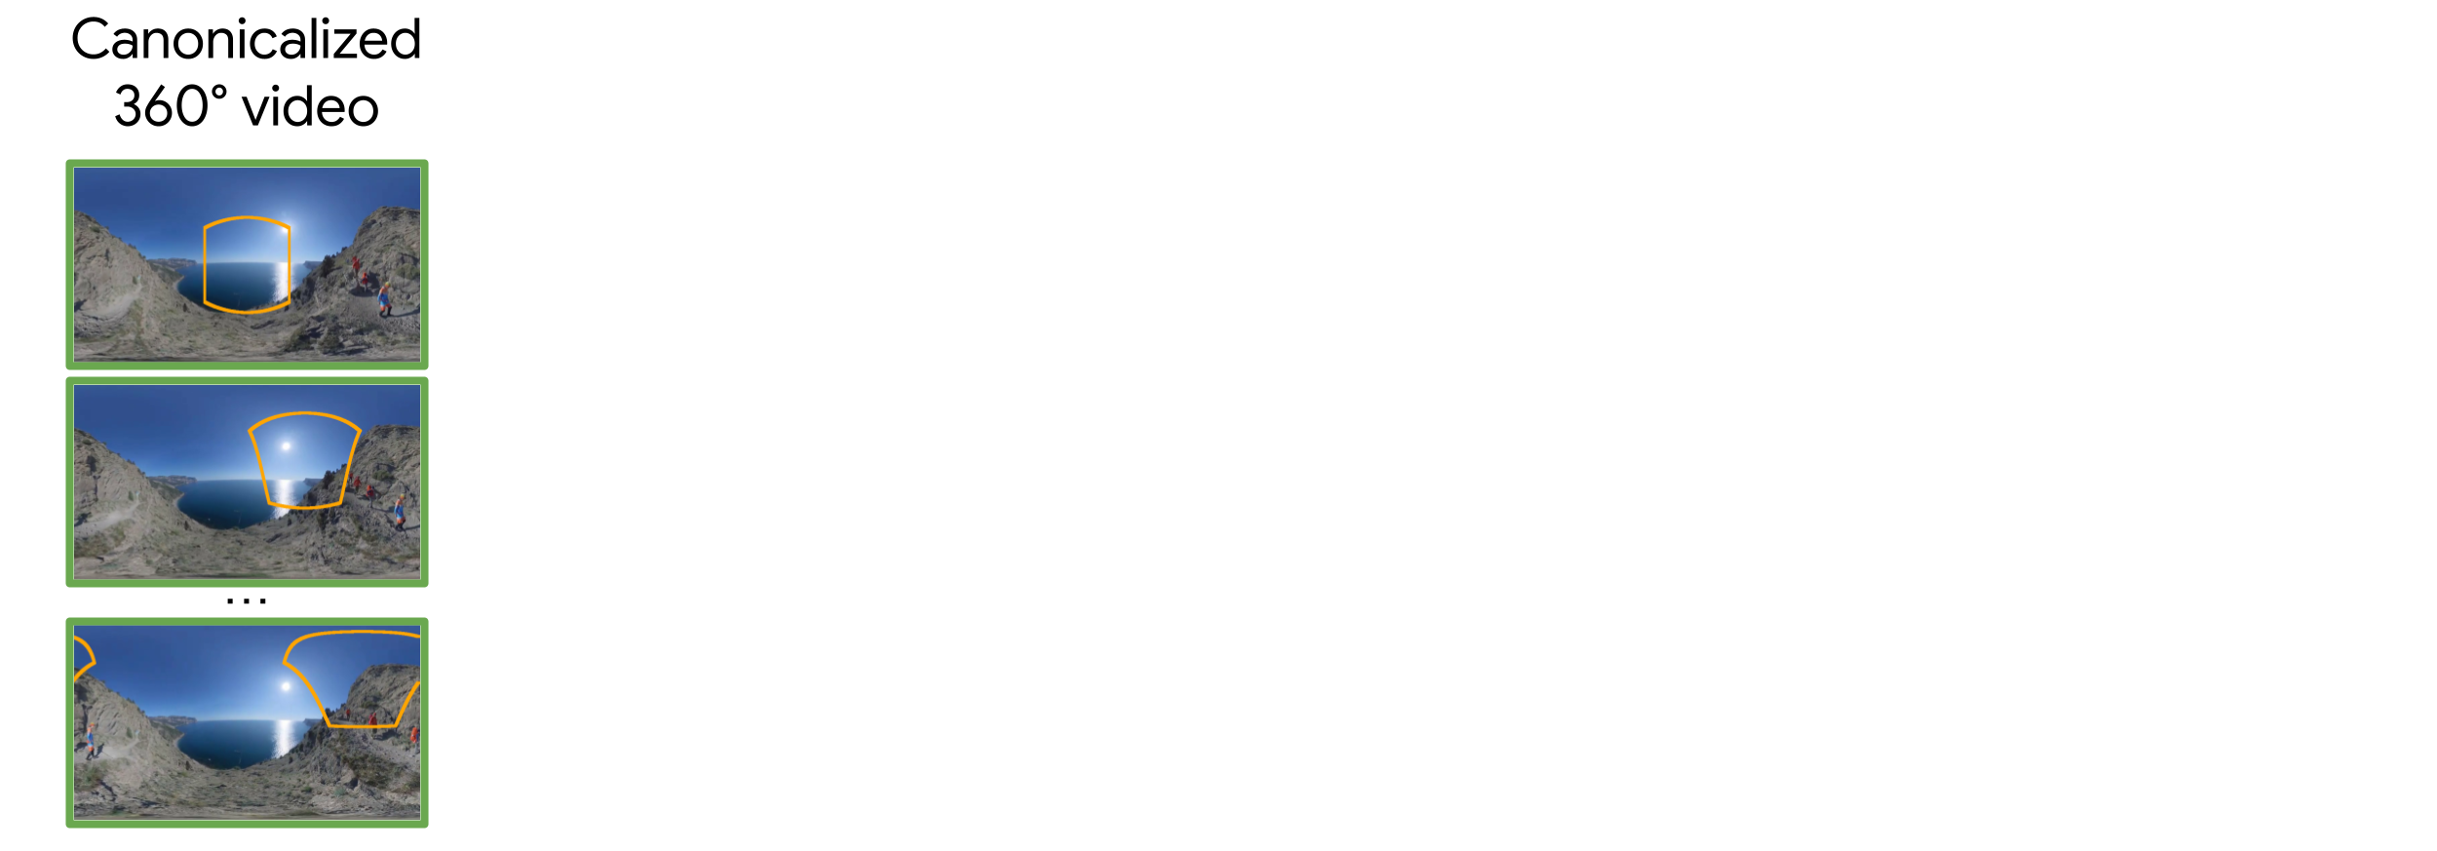
360Anything Pipeline
Notes:
OK now let’s look at our 360Anything pipeline. Given a canonicalized 360deg video as target

Slide 20
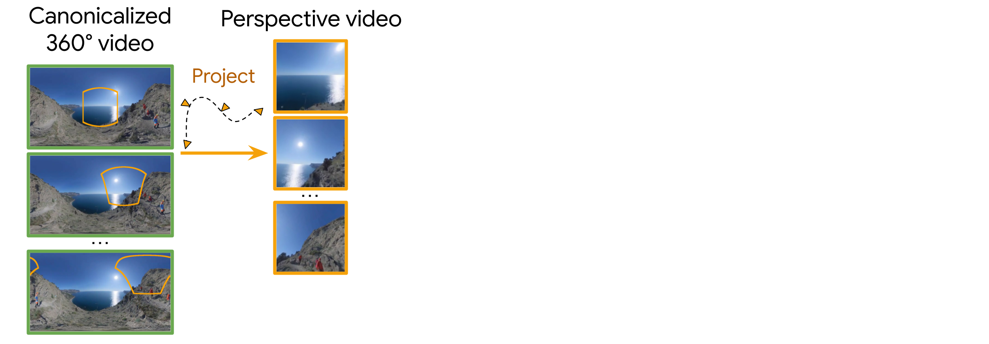
360Anything Pipeline
Notes:
We project it to a perspective video with randomly sampled camera trajectories. It serves as the model conditioning

Slide 21
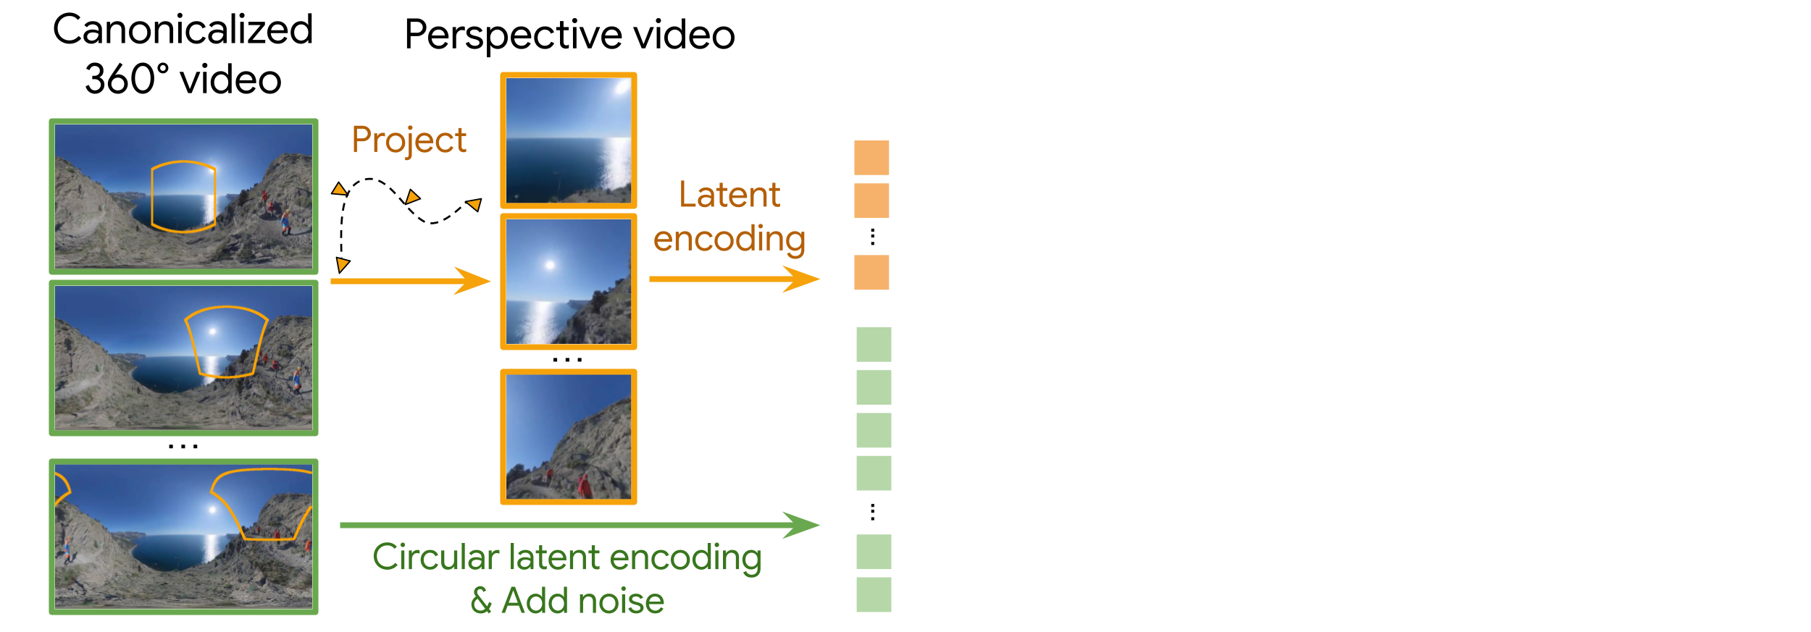
360Anything Pipeline
Notes:
Since we use a latent diffusion model, we encode both the target panorama and the conditioning perspective videos to tokens, and add noise to the panorama tokens. Notice here we use Circular Latent Encoding for panorama, I’ll talk about it later

Slide 22

360Anything Pipeline
Notes:
We then concat the perspective and the noisy panorama tokens along the sequence dimension

Slide 23
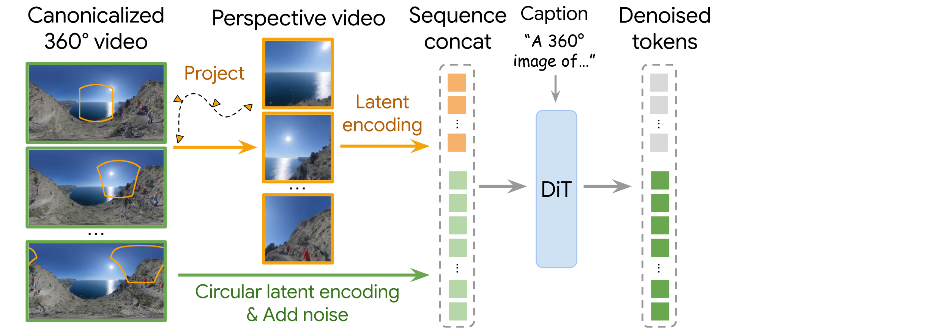
360Anything Pipeline
Notes:
And run a DiT to denoise it conditioned on a text prompt. The DiT thus runs global self-attention on the concated sequence and learns to map perspective pixels to the ERP space, while outpainting unobserved regions

Slide 24
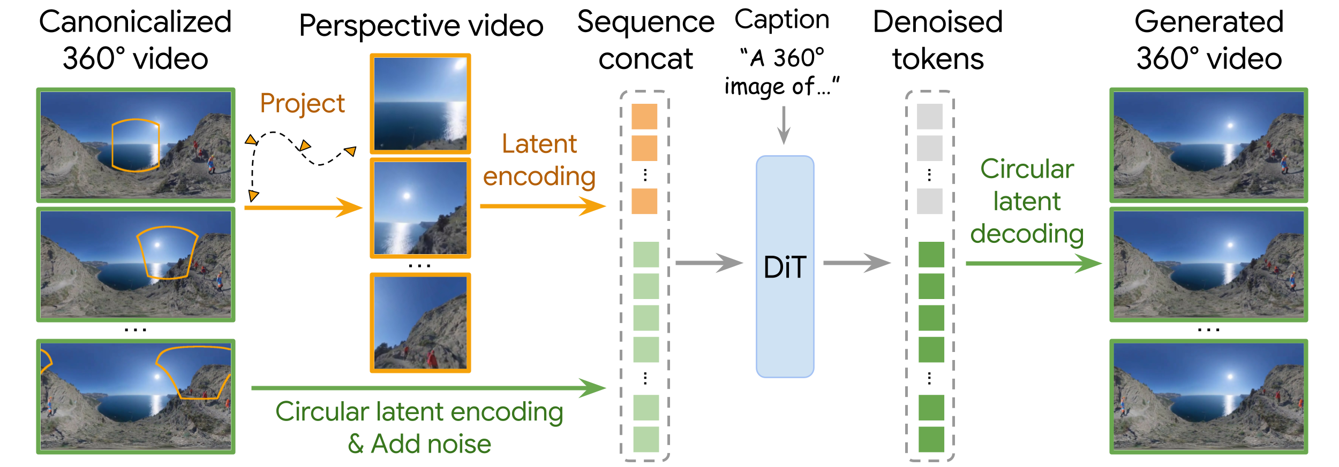
360Anything Pipeline
Notes:
Finally, we only take the output corresponding to the panorama tokens, and can decode them to obtain the generation output

Slide 25
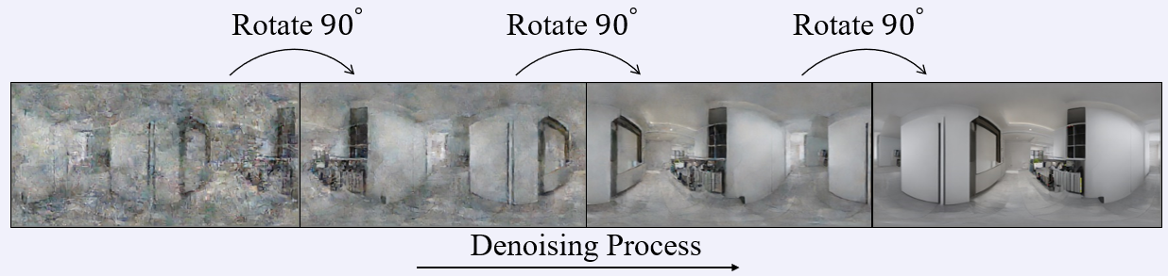
Seam Artifacts
Prior work: inference-time trick, brings overhead
Shift
Wu, Tianhao, Chuanxia Zheng, and Tat-Jen Cham. "PanoDiffusion: 360-degree panorama outpainting via diffusion." ICLR. 2024.
Notes:
OK, so far, we address the challenge of perspective-to-ERP mapping. The next challenge is the seam artifact
Here is a generated panorama image
If we shift it by 180deg, you can see a clear discontinuity at the center, which means the leftmost and rightmost columns in the generation are not smoothly connected. This is because for the model, the two columns have the farthest distance, it’s hard to ensure they are similar
Prior work attributes this to the generation process, and tackle it with inference-time tricks
For example, the rotated decoding shifts the panorama periodically across denoising steps, so that the left and rightmost columns at one step will be connected at the next step
However, inference-time tricks often introduce computation overhead and additional hyper-parameters

Slide 26
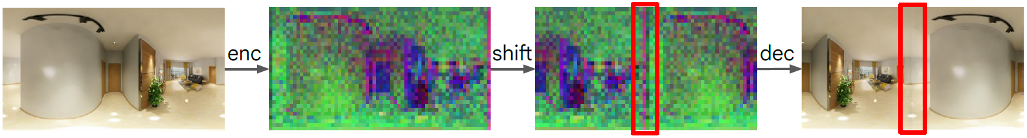
Seam Artifacts
The root cause lies in training – VAE latent encoding!
Zero padding in Conv introduces boundary artifacts
Islam, Md Amirul, Sen Jia, and Neil DB Bruce. "How much position information do convolutional neural networks encode?." ICLR. 2020.
Notes:
Instead, we propose a simple but fundamental fix to the seam artifact
We argue that the root cause of this issue lies not in inference, but the training stage
Modern diffusion models often run in a VAE latent space, and the VAE is often Conv-based
So when you encode the panorama image, the zero-padding in Conv layers will introduce boundary artifacts (recall that paper about positional information leak in CNN
Look at here, this black and purple thing

Slide 27
Seam Artifacts
The root cause lies in training – VAE latent encoding!
Zero padding in Conv introduces boundary artifacts
Islam, Md Amirul, Sen Jia, and Neil DB Bruce. "How much position information do convolutional neural networks encode?." ICLR. 2020.
Notes:
After shifting the latent by 180deg you see the discontinuity here

Slide 28
Seam Artifacts
The root cause lies in training – VAE latent encoding!
Zero padding in Conv introduces boundary artifacts
The latent itself has seam – bad training target
Islam, Md Amirul, Sen Jia, and Neil DB Bruce. "How much position information do convolutional neural networks encode?." ICLR. 2020.
Notes:
And if you decode it, there is a grayish line at the center
This indicates that, while our panorama image is free from seam, the panorama latent is not. Thus it’s a bad training target as it will encourage the generator to reproduce such discontinuity

Slide 29
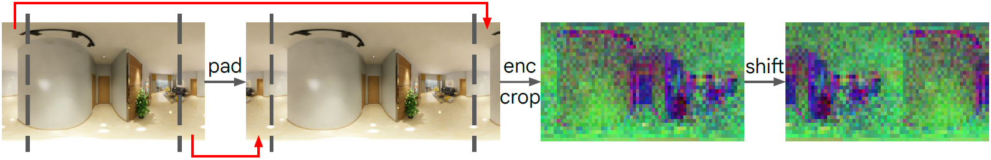
Seam Artifacts
The root cause lies in training – VAE latent encoding!
Zero padding in Conv introduces boundary artifacts
The latent itself has seam – bad training target
Our solution: Circular Latent Encoding
Notes:
Our solution is simple
To remove seams in the latent representation, we perform circular padding with columns from the opposite side

Slide 30
Seam Artifacts
The root cause lies in training – VAE latent encoding!
Zero padding in Conv introduces boundary artifacts
The latent itself has seam – bad training target
Our solution: Circular Latent Encoding
Notes:
After encoding, we drop latent tokens corresponding to the padded regions. And now the latent representation doesn’t contain seam, which serve as a clean training target

Slide 31
Seam Artifacts
The root cause lies in training – VAE latent encoding!
Zero padding in Conv introduces boundary artifacts
The latent itself has seam – bad training target
Our solution: Circular Latent Encoding
No training/inference overhead!
Notes:
Importantly, since we drop the padded regions, we keep the same number of tokens as DiT input, and thus doesn’t introduce any training or inference overhead. You only need to change 3 lines of code

Slide 32
Experiments
https://360anything.github.io/
Datasets:
Image: rendering of indoor rooms + in-the-wild panorama images
Video: YouTube panorama videos
Captioned with Gemini
Zheng, Jia, et al. "Structured3D: A large photo-realistic dataset for structured 3d modeling." ECCV. 2020.
Wallingford, Matthew, et al. "From an image to a scene: Learning to imagine the world from a million 360 videos." NeurIPS. 2024.
Notes:
OK now let’s look at experiments. We experiment in both image and video domain
For image, we follow prior work to use panorama images rendered from indoor rooms, and a few (less than 10%) in-the-wild data
For video, we train on YouTube panorama videos with some filtering
Both data are captioned using Gemini

Slide 33
Experiments
Task: outpaint panorama from perspective input
Metric: FID-variants, CLIP-score, VBench
Baselines:
Camera-based: we provide GT camera at test time
Camera-free: always treat input as front-view + FoV=90°
Our implementation:
FLUX (image), Wan 2.1 (video)
Randomize camera FoV & orientation during training
No access to camera information
Huang, Ziqi, et al. "VBench: Comprehensive benchmark suite for video generative models." CVPR. 2024.
FLUX.1-dev: https://huggingface.co/black-forest-labs/FLUX.1-dev
Wan, Team, et al. "Wan: Open and advanced large-scale video generative models." arXiv. 2025.
Notes:
Our task can be considered a special case of outpainting. We adopt common metrics like FID for fidelity, CLIP-score for text alignment, and Vbench metrics for overall visual quality
We compare with many baselines in the paper, which can be mainly categorized to 2 groups. One that use camera metadata to project perspective input to the ERP space. For these methods, we provide them GT camera at test time
Another type of methods are camera-free. They always put input at the center of the ERP with 90deg FoV
as shown in this example
For our 360Anything model, we fine-tune FLUX for image and Wan 2.1 for video
To make the model robust to camera metadata, we randomly sample FoVs and orientations to crop perspective videos during training
Notiably, our model has no access to camera information at test time, it has to infer everything from the perspective video

Slide 34
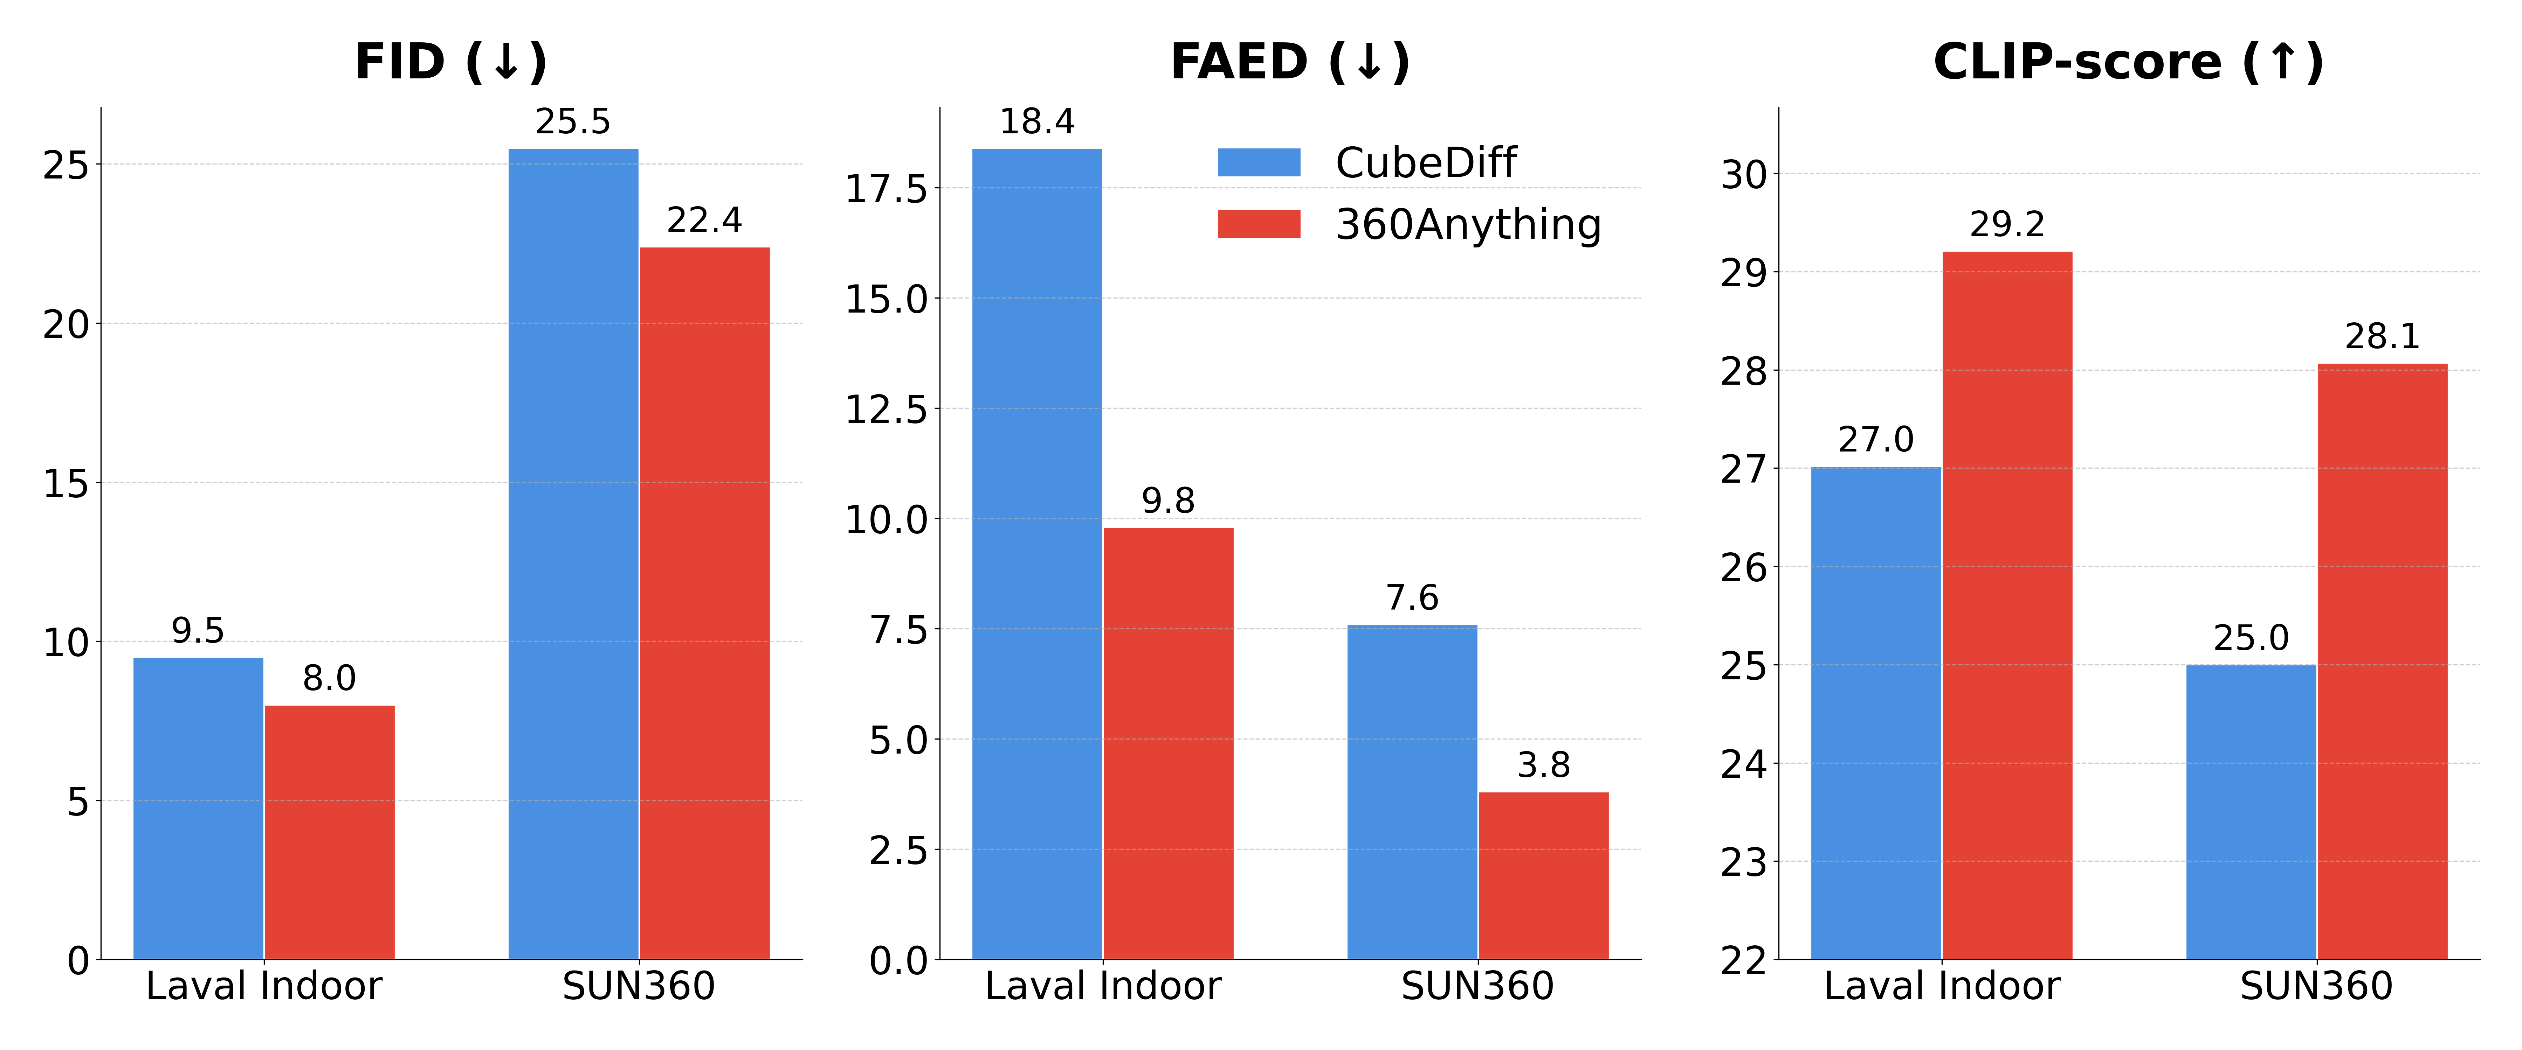
Perspective-to-360° Image
FAED: better panorama structure
Kalischek, Nikolai, et al. "CubeDiff: Repurposing diffusion-based image models for panorama generation." ICLR. 2025.
Notes:
Quantitatively, for image generation, we will show the best baseline CubeDiff. We improve FID, FAED, and CLIP-score
FAED extracts first panorama features using an AE fine-tuned on ERP images, and then compute FID on these features. We significantly improve this metric, showing that 360Anything learns the correct ERP geometry

Slide 35
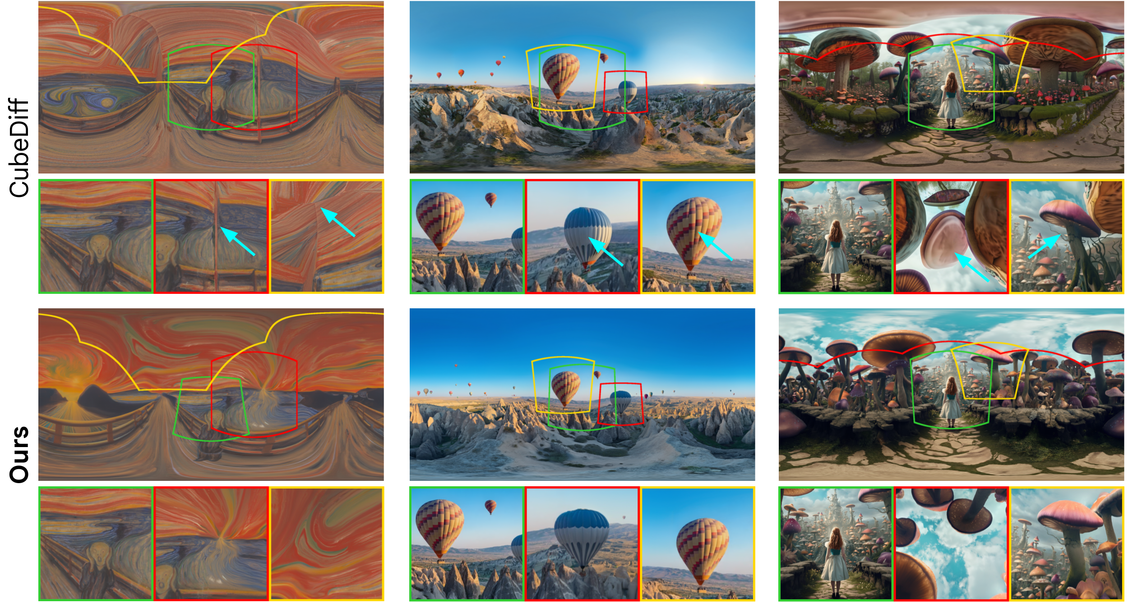
CubeDiff
Ours
Notes:
Qualitatively, we compare the generated panorama, and projected perspective views. The green one is the input image. CubeDiff sometimes produce artifacts near the boundary of the conditioning view
CubeDiff always treats input as 90deg FoV. Yet when the actual FoV is smaller, it has to stretch the objects at the image boundary, leading to distorted structure, like this ballon
and this mushroom
In contrast, 360Anything adapts to different FoV and camera orientation. As you can see the green box is smaller with a non-zero rotation

Slide 36

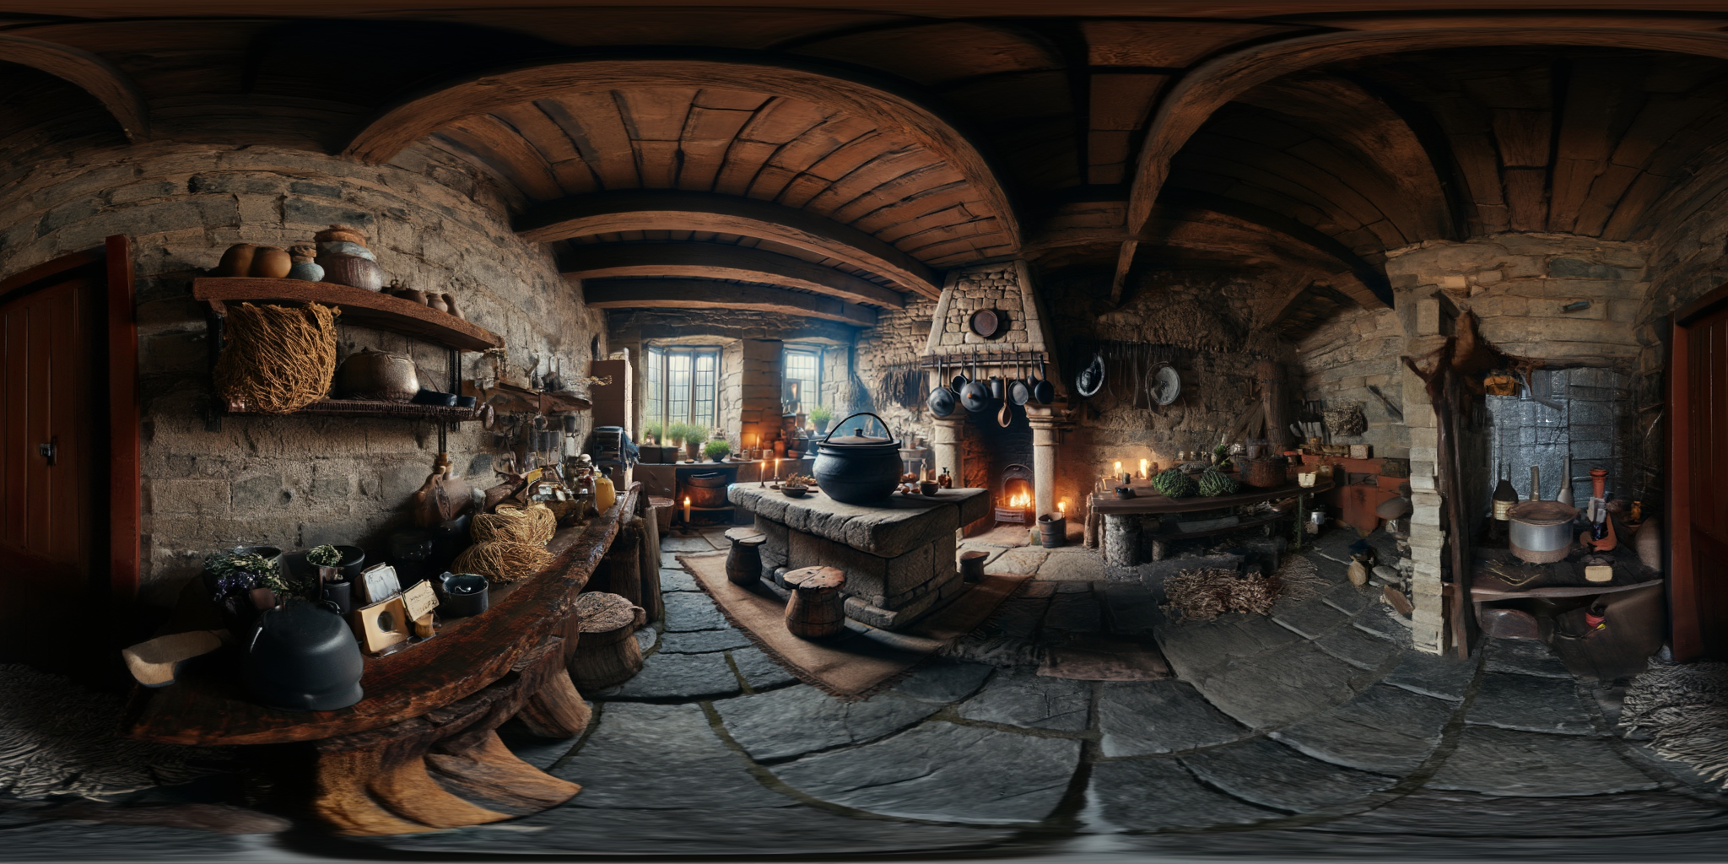
Notes:
Here are more results on AI generated images. We also project the side views facing left, front, right, and back under the panorama. Recall our training data are mostly indoor rooms and real-world panoramas, these samples are OOD but our model still generalizes
Here are three more examples

Slide 37
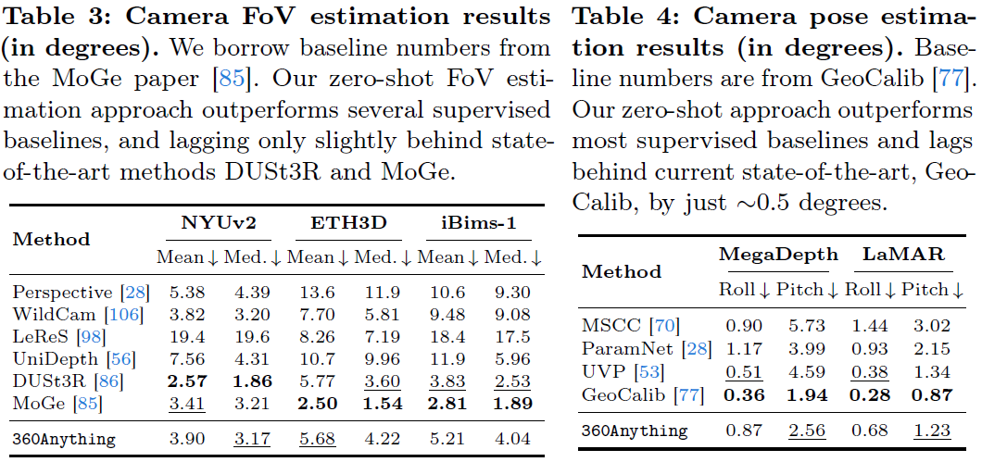
Perspective-to-360° Image
How accurate is our estimated camera metadata?

Slide 38
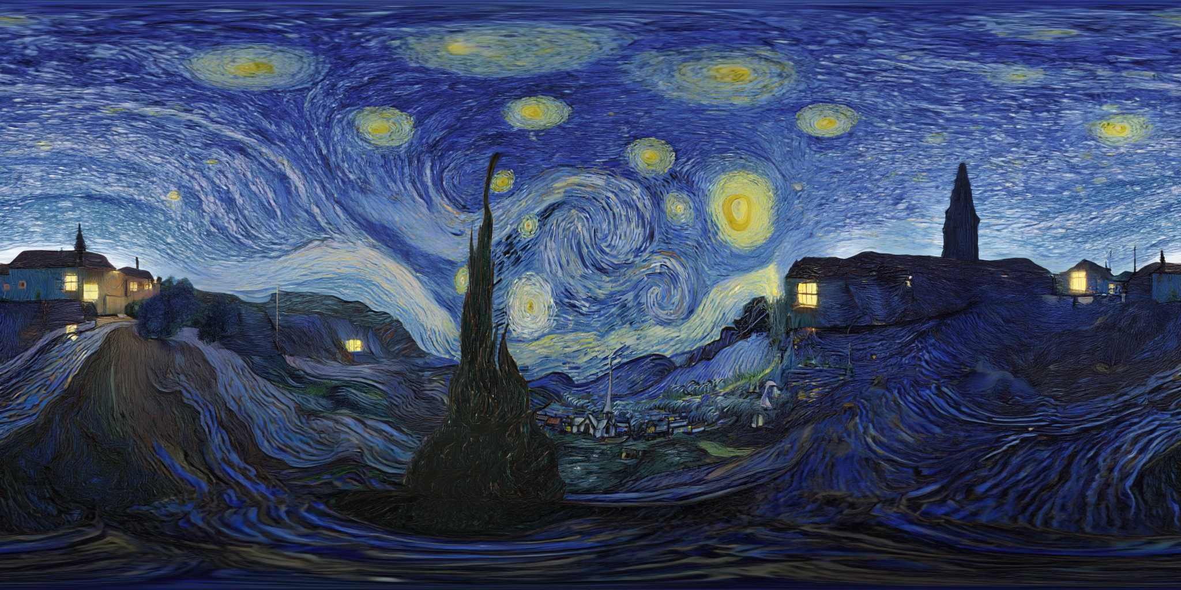
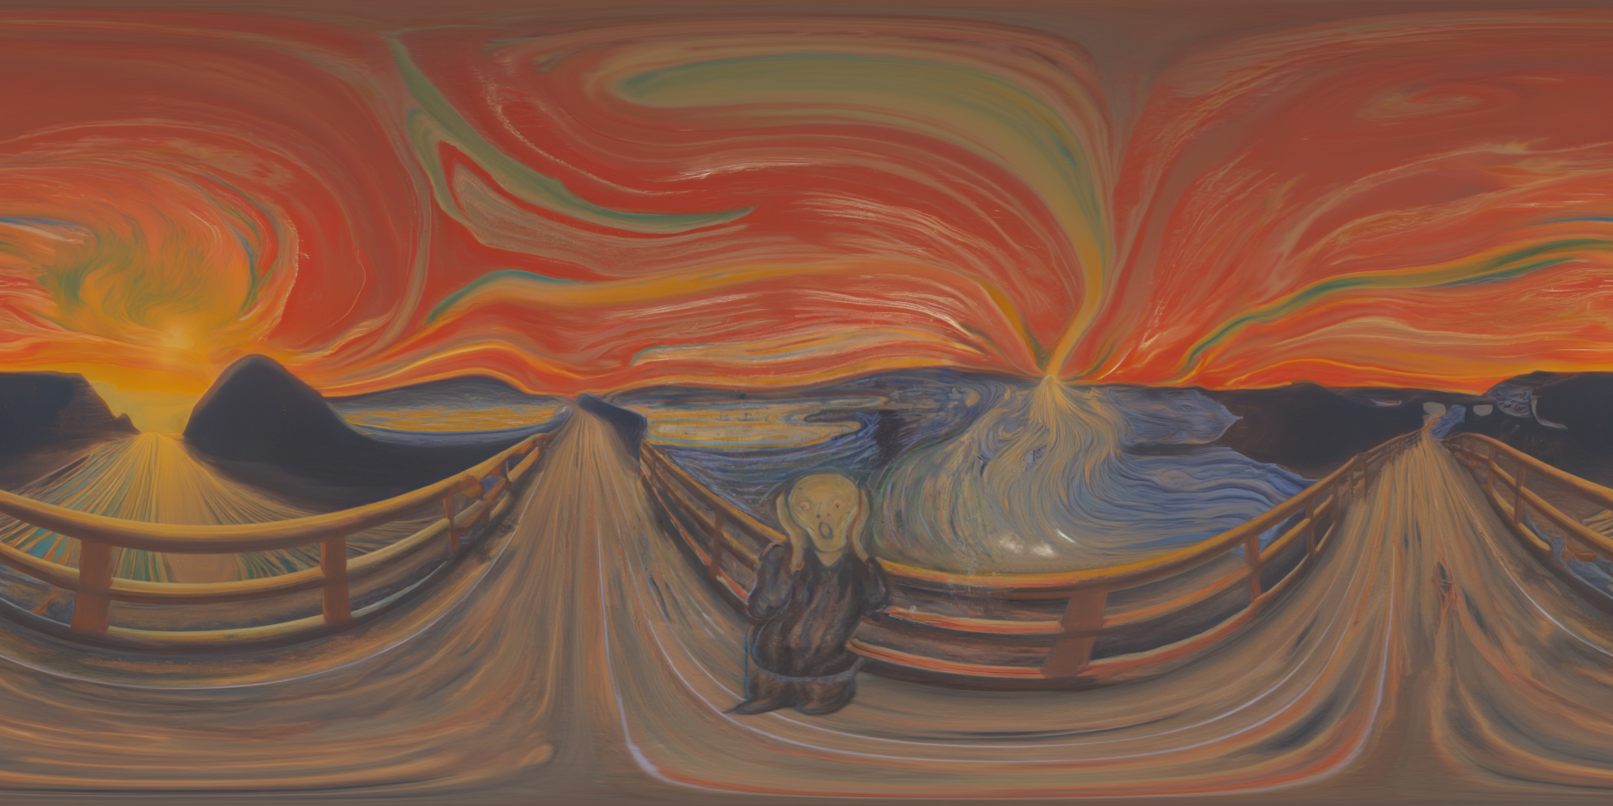
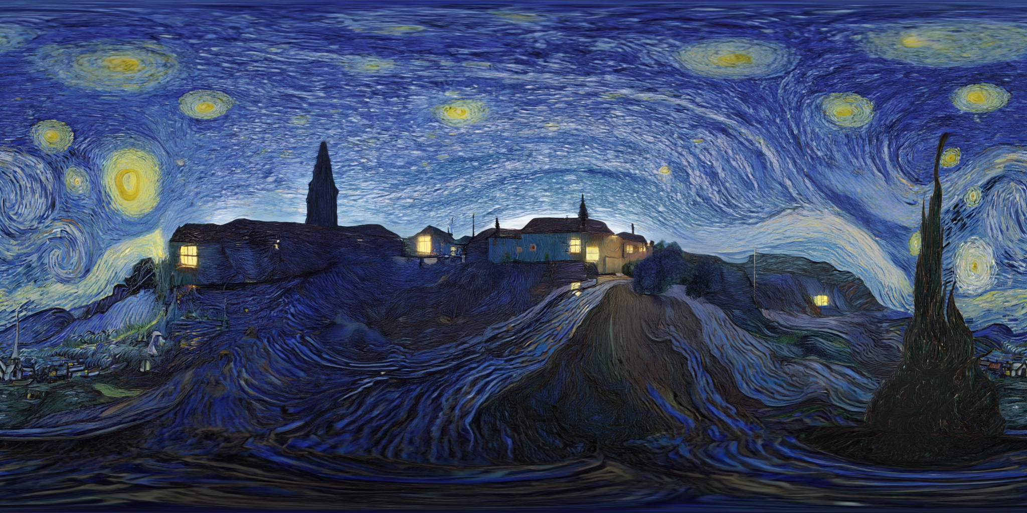

Notes:
Here, we shift the generated panorama by 180 degree
The center is smoothly connected, meaning there is no seam

Slide 39

Perspective-to-360° Video
LPIPS: better input preservation even without camera metadata!
Fang, Zixun, et al. "Panoramic Video Generation with Pretrained Diffusion Models." NeurIPS. 2025.
Notes:
For panorama video generation, again we achieve the best LPIPS, FVD, and Aesthetic Quality from VBench
LPIPS measures the reconstruction of input perspective on the generated panorama. Surprisingly, we are better than ViewPoint which uses pixel-aligned conditioning. This proves that 360Anything learns to infer the correct camera trajectory of the input

Slide 40






Perspective-to-360° Video
Input
ViewPoint
Ours
Notes:
Here are some qualitative results. ViewPoint generates distorted humans and buildings. Our result is more stable. In addition, notice that the input video captures some people only towards the end of the video, yet our model generates them from the beginning of the panorama video. This demonstrates that our model understands object permanence, objects cannot suddenly appear in the scene, they should already be there
In this example, there is a hand in the conditioning video. Only 360Anything outpaints the entire person around it. It also infers roll rotation of tilted camera

Slide 41


Perspective-to-360° Video
Interactive 360 viewer:
https://360anything.github.io/
Notes:
Here are more qualitative results. Again, we test on AI generated videos like this famous Sora lady
Definitely check out our project page to view the panorama in a 360 viewer

Slide 42


Perspective-to-360° Video
Notes:
For this car, you see the dust persists behind it after it drives by

Slide 43


Perspective-to-360° Video
Notes:
This is a video with filming style, we generate a man running in a empty street

Slide 44

Perspective-to-360° Video
Notes:
Here is another generation from the same input but under a different random seed. This time it generates a man at the back of the scene chasing the man in the input. Probably this is why the man is running in such a hurry

Slide 45


Perspective-to-360° Video
Notes:
Here we show some challenging input videos with large object or camera motion. We annotate the camera trajectory inferred by our model with this red border
Here we have a high-speed drone fly-through

Slide 46


Perspective-to-360° Video
Notes:
And mountain biking

Slide 47



3D Scene Reconstruction
Input
Generated Panorama Video
Rendered Views from 3DGS
Kerbl, Bernhard, et al. "3D Gaussian splatting for real-time radiance field rendering." ToG. 2023.
Notes:
OK now this is really the last experiment I’ll talk about. We study whether panorama outpainting can help 3D scene reconstruction
A perspective video often has limited coverage of the scene, and training 3D reconstruction such as 3DGS on it will fail due to not enough parallax
We can outpaint the input to a panorama video covering the entire scene and thus a lot of parallax
From which we can train a 3DGS model and render novel views. The back of the scene is never observed by the input, so this is fully hallucinated by the model

Slide 48



3D Scene Reconstruction
Input
Generated Panorama Video
Rendered Views from 3DGS
Notes:
Here is another example. This oven is never seen in the input, and hallucinated from the initial frames

Slide 49

Robustness to Camera Variations

Slide 50


Limitations & Future Directions
Some physical phenomena are still hard
Notes:
I’ll discuss some limitations and potential future works
First of all, although panorama encodes more world knowledge like object permanence, it’s still implicit. Thus, you would still expect some errors. In this example the mirror captures a man, so there should a real man at the opposite side of the camera, but 360Anything fails to generate it

Slide 51
Limitations & Future Directions
Some physical phenomena are still hard
Low dynamic range
Notes:
Second, our model can only handle standard digital images that have a low dynamic range (LDR). But compared to a narrow FoV video, a panorama video often covers sky which is much brighter than other part of the image. As a result, you often see over-exposure on the sky or regions that are too dark. To solve this, I think we need techniques to process high dynamic range (HDR) videos

Slide 52

Limitations & Future Directions
Some physical phenomena are still hard
Low dynamic range
Panorama requires A LOT OF tokens. ERP data is 8$×$ perspective data
Hard to scale up
I tried perspective upsample models, degrade results due to domain gap
Notes:
Another big issue with panorama generation is the computation cost. Since we cover full 360deg FoV, the resolution is very high, for example, ERP has 8x the number of tokens compared to a normal perspective video
This just makes it hard to scale up to higher resolution and longer videos
I tried using a video upsampling model trained for perspective videos. However, it distorts the ERP structure and re-introduces seams due to the domain gap

Slide 53

Limitations & Future Directions
Some physical phenomena are still hard
Low dynamic range
Panorama requires A LOT OF tokens. ERP data is 8$×$ perspective data
5s is limited for large scenes
360Anything is robust to FPS change, can go to 15s
Autoregressive gen?
Notes:
Finally, our current model can only process 5s videos (or 81 frames)
While it’s quite robust to different FPS, some of my testing videos are downsampled from 15s. It’s still not enough if we want to cover a really large scene
One potential direction is to distill the bidirectional video diffusion model to a causal and autoregressive model. This way we can significantly speed up inference and context length
However, a panorama generator often uses future observation to complete the panorama at the current time, if you remember this example. So having a causal model will break this, and the model will have some large state change if new thing appear

